Slide 1
UEC COLLEGE OF NURSING, OCHADAMU.
Course Title Community Health Nursing
Course Code GNS 313
Third year First Semester
Topic Epidemiology and control of Infections Via Skin and mucous membranes.

Slide 2
TRACHOMA
Trachoma is an infectious disease caused by BACTERIUM CHLAMYDIA TRACHOMATIS.
The infection causes a roughening of the inner surface of the eyelids.
This roughening can lead to pain in the eyes, breakdown of the outer surface or cornea.

Slide 3
EPIDEMIOLOGY
As of 2011, approximately 21million people are actively affected by trachoma, 51 countries are currently classified as endemic for blinding trachoma. Of these, Africa is considered the worst affected area, with over 85%.

Slide 4
STAGES (TYPES) OF TRACHOMA.
Trachomatous inflammation-follicular
Trachomatous inflammation-intense
Trachomatous Scarring
Trachomatous Trichiasis
Cornear Opacity

Slide 5
CAUSES OF TRACHOMA
There are different types of which are type A,B,Ba,C, cause blinding trachoma.
Other types D to K are associated with sexually transmitted CHLAMYDIA infection.
Poor Sanitation
Unclan water supply
Lack of regular face washing

Slide 6
Common Cauuses Of Vision loss :
Diabetic Retinopathy
Glaucoma
Age - related macular degeneration
Cateracts

Slide 7
SIGH AND SYMPTOM
Irritation of the eye with tearing
Pain
Light sensitivity
Presence of follicles
Redness
Scarring
Cornear Opacity
Vision loss

Slide 8
DIAGNOSIS
Aid of a light and simple magnifiers.
PROGNOSIS FOR TRACHOMA
Community -- based implementation of the SAFE strategy improved the prognosis. For millions of at risk individuals.
Early treatment before Scarring of the eyelids and cornea, the prognosis for preservation of vision is excellent.

Slide 9
MANAGEMENT
Environmental improvement (such as access to clean water and hygiene measures to reduct the fly population) to reduce human transmission.
Facial cleanliness to reduce human transmission
Antibiotics (Azithromycin) to treat active infection
Surgery to correct In - turned eyelids and Trichiasis.

Slide 10
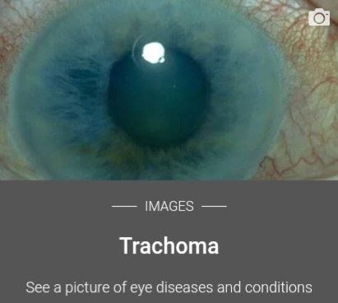
Happy Reading And Study More

